Slide 1
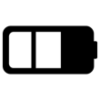
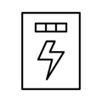
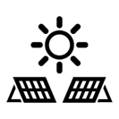
Malaysian Regulatory Regime Five government-led initiatives have increased the attractiveness of solar in Malaysia
Net Energy Metering
(NEM)
Self-Consumption
(Selco)
Supply Agreement with Renewable Energy
(SARE)
New Enhanced Dispatch Agreement (NEDA)
Large Scale Solar (LSS)
Program to sell any excess solar generated electricity back to the grid at market rate
Electricity sold will be converted to credits and offset against final electricity bill
Policy which enables homes or businesses to generate solar electricity to reduce utility cost and carbon footprint
Solar electricity generated must all be consumed, not sold
Tripartite contract between prosumer, asset owner and TNB that protects both asset owner and prosumer
TNBX will act as collecting agent (incl. metering, billing, collection) for asset owners at a fee
Program which allows companies to operate as Merchant Generators to sell energy to a Single Buyer
Designed to encourage competition and cost efficiency
Scheme which enables businesses to operate solar PV farms with capacity ranging from 10MWac to 50MWac
License to operate obtained via competitive bidding
Applicable to commercial and industrial solar
Applicable to utility scale solar
Source: Sustainable Energy Development Authority of Malaysia, TNBx

